Slide 1
Predictive Maintenance of industrial machinery
CAPSTONE PROJECT
Presented By:
1. Abhishek Yadav-Chandigarh University-Computer Science Engineering

Slide 2
OUTLINE
Problem Statement
Proposed System/Solution
System Development Approach
Algorithm & Deployment
Result (Output Image)
Conclusion
Future Scope
References

Slide 3
Problem Statement
Traditional maintenance is reactive → leads to unexpected failures, downtime, and costly repairs
Objective: Develop a predictive classification model to anticipate failure types before they occur
Use sensor-based data to forecast failures like:
Tool wear
Power failure
Heat dissipation issues

Slide 4
Proposed Solution
The proposed system aims to address the challenge of predicting potential industrial machinery failures before they occur, thereby enabling proactive maintenance and minimizing unexpected downtime. The solution leverages data analytics and machine learning techniques through IBM Watsonx.ai to classify different types of machine failures accurately. The solution will consist of the following components:
Data Collection:
Gather historical operational data from industrial machines, including sensor readings such as temperature, torque, tool wear, vibration, and power consumption.
Include failure labels like tool wear failure, heat dissipation failure, power failure, etc., to train the classification model.
Data Preprocessing:
Clean and preprocess the data to address missing values, outliers, and inconsistencies.
Use automatic feature engineering and transformation pipelines provided by IBM Watsonx.ai AutoAI.
Normalize and encode features for compatibility with machine learning algorithms.
Machine Learning Algorithm:
Utilize IBM Watsonx.ai’s AutoAI to explore multiple model architectures automatically.
AutoAI selects the best-performing algorithm—SNAP Random Forest in this case—with hyperparameter optimization and feature selection.
The classifier is trained to predict one of several failure types (multi-class classification).
Deployment:
Deploy the final model using IBM Watsonx.ai's deployment capabilities.
The model is exposed as a REST API endpoint that can be integrated with dashboards or alert systems.
Allows real-time inferencing using live sensor inputs from the machine network.
Evaluation:
Evaluate the model using accuracy, confusion matrix, precision, recall, and F1-score.
Achieved a maximum accuracy of 99.5%, indicating highly reliable failure prediction.
Ongoing performance monitoring and feedback loop enable model fine-tuning for long-term effectiveness.

Slide 5
System Approach
Step 1: Data acquisition from Kaggle
Step 2: Preprocessing via AutoAI (feature scaling, encoding)
Step 3: Model training using AutoAI-generated pipelines
Step 4: Evaluation using accuracy, precision, recall, F1-score
Step 5: Model deployment (Watsonx Studio Deployment → optional API)

Slide 6
Algorithm & Deployment
Algorithm Selection:
Chosen by IBM Watsonx.ai AutoAI: SNAP Random Forest
Justification: High accuracy (99.5%), handles multiclass classification, robust to noise and overfitting
Data Input:
Sensor data: Temperature, Torque, Tool Wear, Rotational Speed
Metadata: Machine Type, Product ID
Target: Failure types (Tool Wear, Power, Overstrain, etc.)
Training Process:
AutoAI performed:
Feature engineering & preprocessing
Cross-validation & hyperparameter tuning
Model selected based on best F1-score & accuracy
Prediction Process:
Real-time sensor inputs → model predicts failure type
Supports proactive maintenance before breakdowns occur

Slide 7
Result
Pipeline Comparison
Result
Input Data
Pipeline Leaderboard

Slide 8
Conclusion
Developed a high-performing predictive maintenance system
Model can proactively alert teams to upcoming machine failures
Reduces:
Unplanned downtime
Repair costs
Operational delays

Slide 9
Future scope
Integrate with real-time IoT sensors via edge devices
Build a dashboard for maintenance teams
Implement continuous learning to adapt to new patterns
Expand failure prediction to other industries: automotive, energy, etc.

Slide 10
References
Kaggle Dataset: https://www.kaggle.com/datasets/shivamb/machinepredictive-maintenance-classification
IBM Watsonx.ai Documentation: https://dataplatform.cloud.ibm.com/

Slide 11
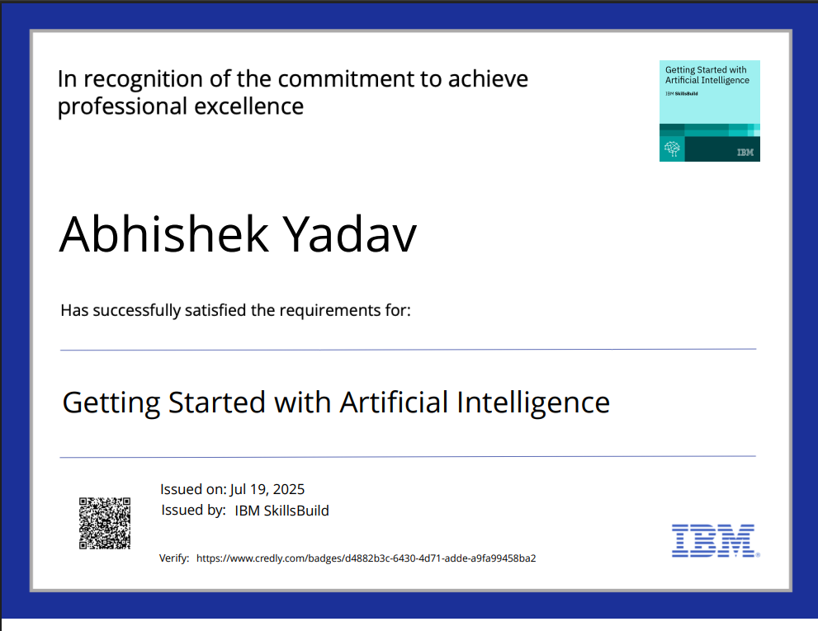
IBM Certifications
Screenshot/ credly certificate( getting started with AI)

Slide 12
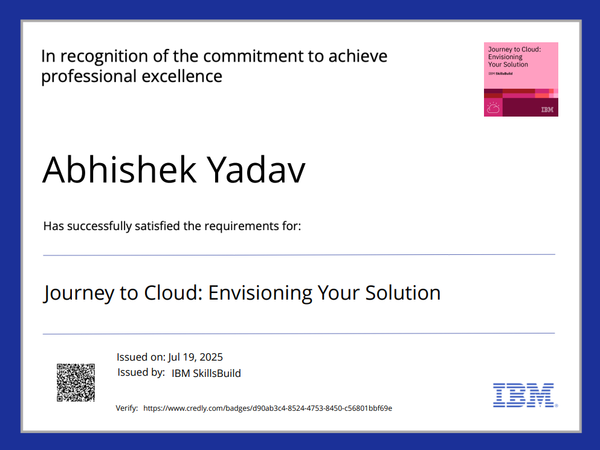
IBM Certifications
Screenshot/ credly certificate( Journey to Cloud)

Slide 13
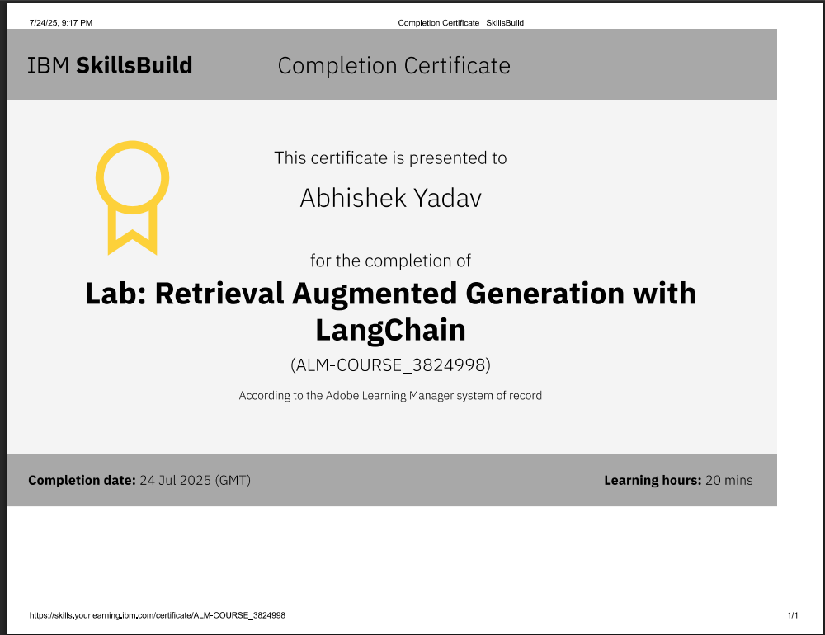
IBM Certifications
Screenshot/ credly certificate( RAG Lab)

Slide 14
THANK YOU

